Slide 1
MQ-2 Smoke/gas Sensor
Smart Home Monitor – Lucas Finiello

Slide 2
Introduction
Smart Home Monitor System ( includes motion detection, temperature/humidity detection and smoke/gas detection)
Sensor: MQ-2 Smoke/Gas – LPG(liquified petroleum gas), Butane, Methane.
Development platform used: STM32Duino Blue Pill – with Arduino Boot Loader

Slide 3


Budget
Old
Initial Buys:
Willwin 2pcs MQ-2 MQ2 Smoke Gas LPG Butane Methane Sensor Detector Module for Arduino
STM32Duino Blue Pill with CS32F103C8T6 - Arduino Compatible - with Arduino Boot Loader
Future Buys:
Seloky 143Pcs 2.54mm Straight Single Row PCB Board Female Pin Header Socket Connector Strip Assortment Kit for Prototype Shield (4Pin 6Pin 8Pin 10Pin)
SunFounder Active Buzzer Sensor Module for Arduino and Raspberry Pi
Gikfun FT232RL 3.3V 5.5V FTDI USB to TTL Serial Adapter Module for Arduino Mini Port (Pack of 2pcs) AE1186x2
120pcs Jumper Wires / Dupont Cable 20cm Length
New

Slide 4
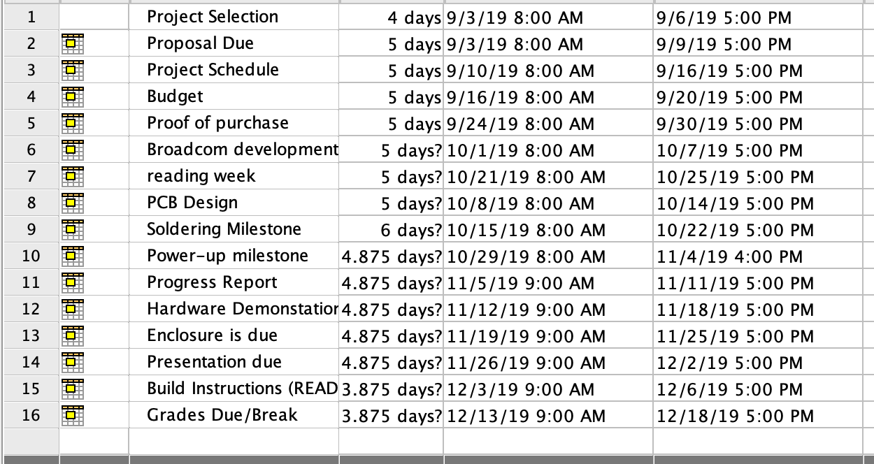
Schedule
Started to fall behind in week 8
-Finished Breadboarding and PCB soldering in week 11.
- Encasing was completed in week 12.

Slide 5
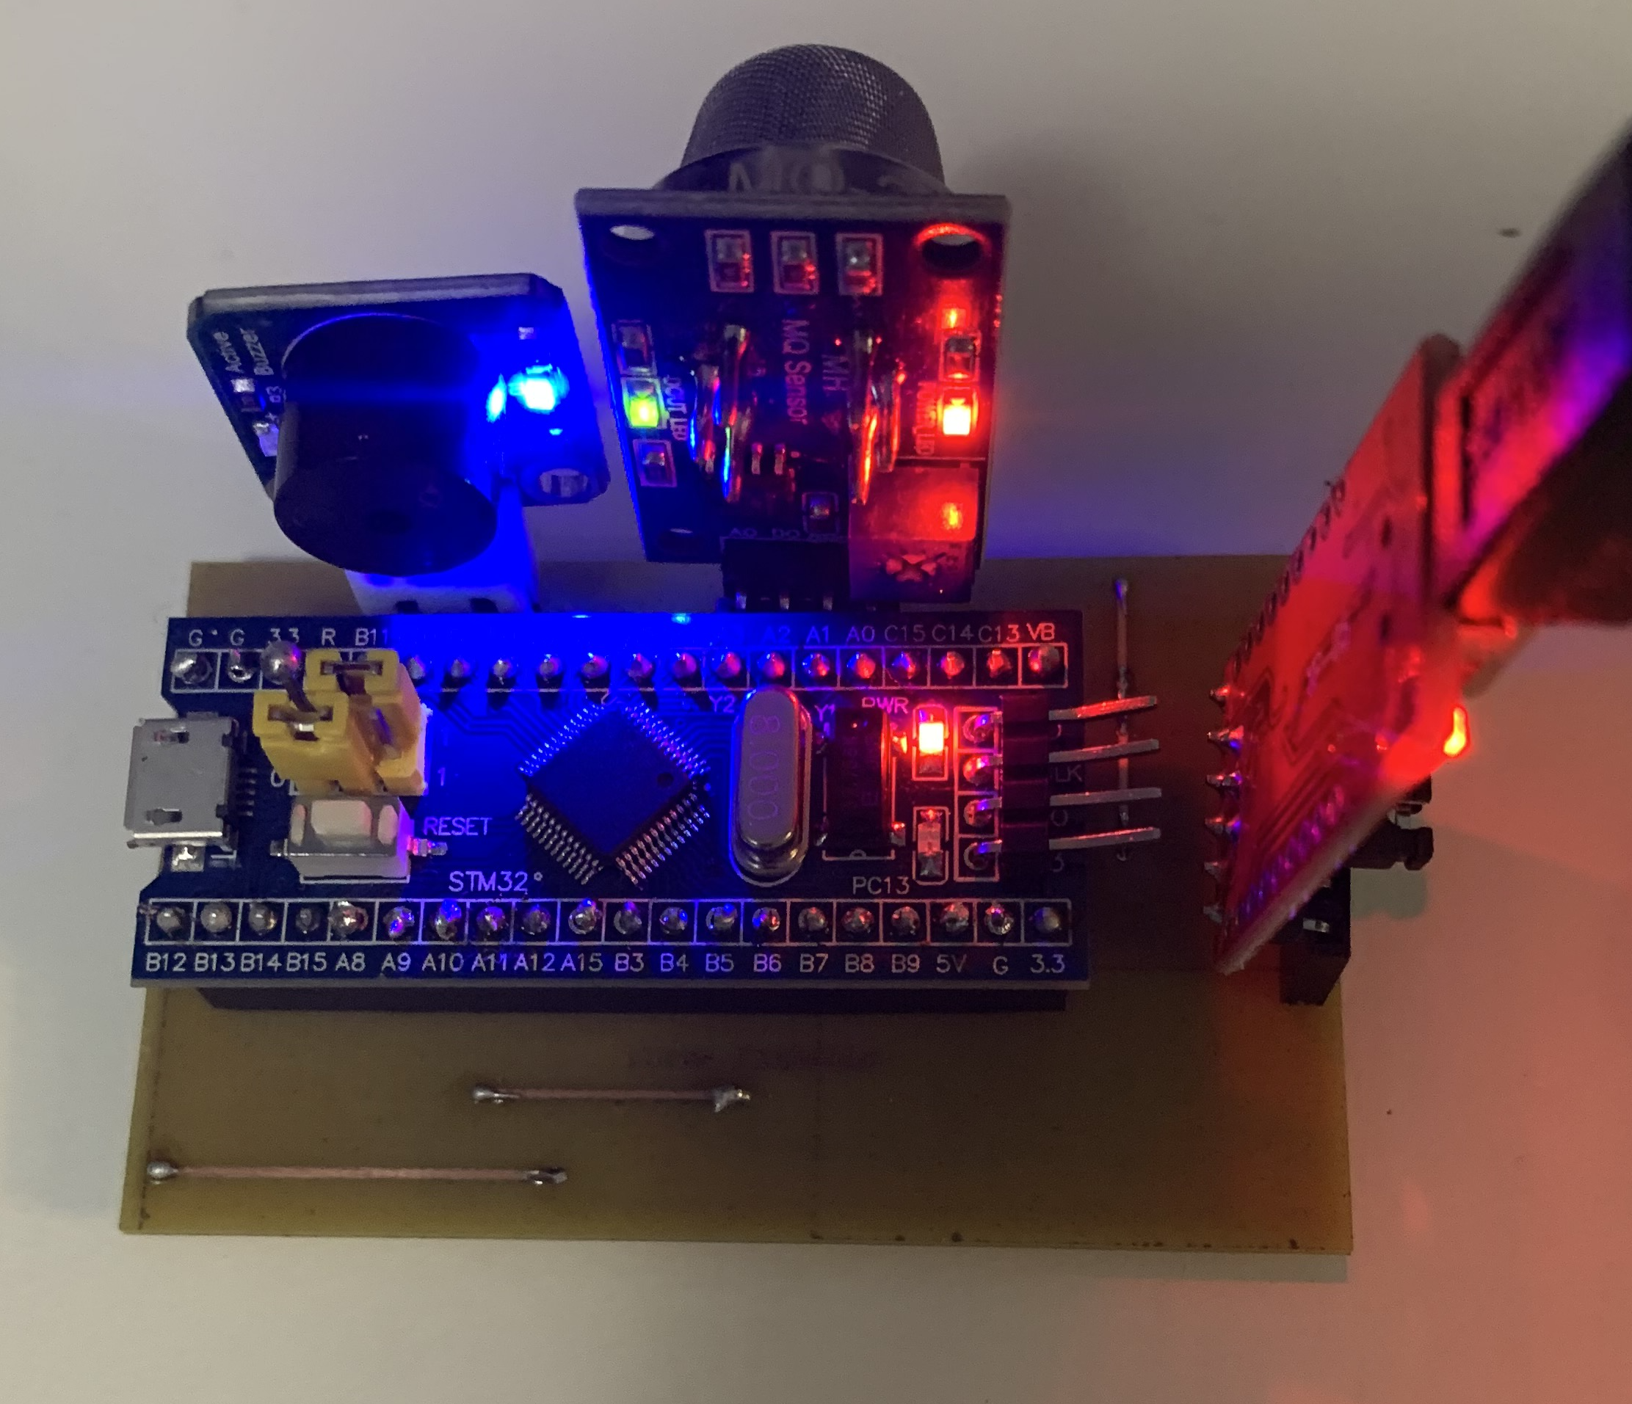
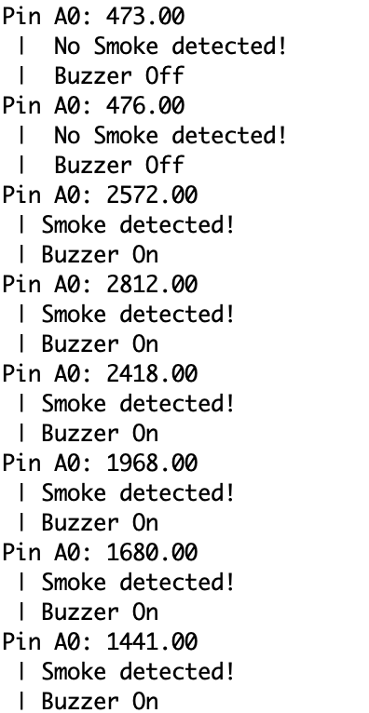
Images
Side Note:
Will Have enclosure for my presentation.
Im having issues with sizing but will have it done for my presentation.

Slide 6
Course Knowledge & Outside Knowledge
Course:
Electric Circuits
Introduction to Software Engineering
Embedded Systems
Technical C
Other:
https://github.com/IshanKhuttan/HumberNavigator
https://www.youtube.com/watch?v=Ze6q6NidS5w

